Slide 1


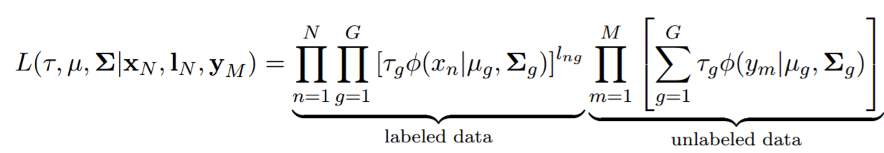
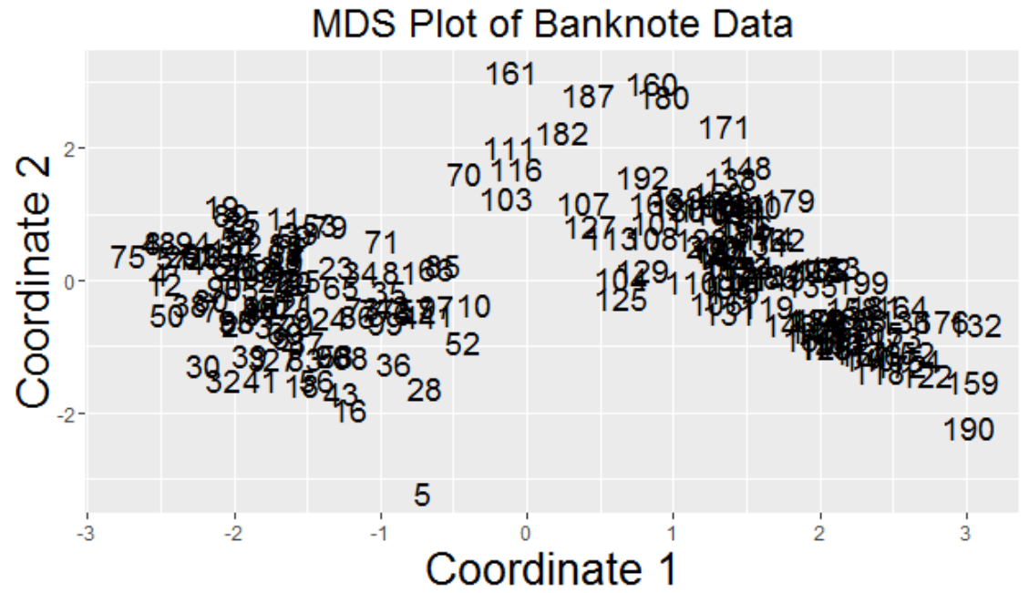
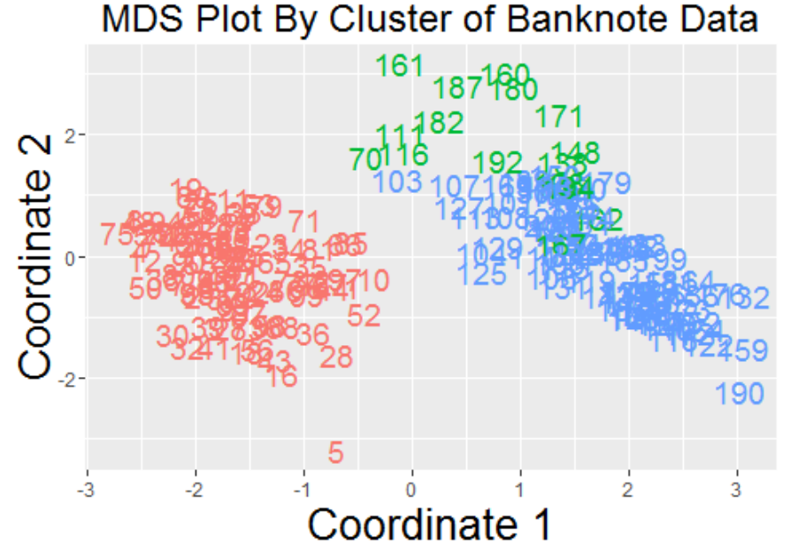
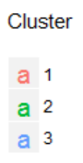
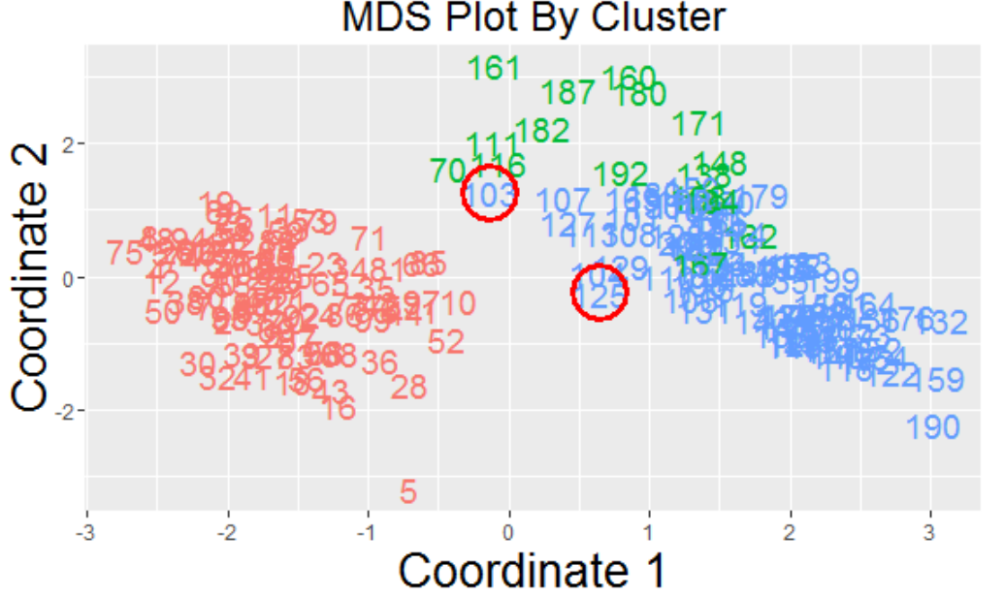
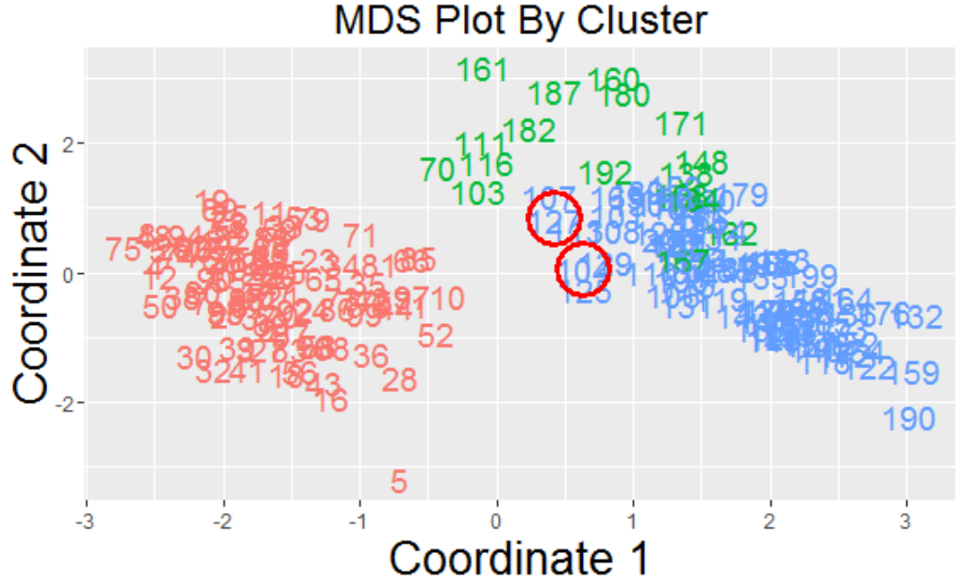
Exploring Interactive Model-Based Clustering
Lina Sheremet [Department of Statistics, Carnegie Mellon University], Samuel Ventura [Department of Statistics, Carnegie Mellon University],
Rebecca Nugent [Department of Statistics, Carnegie Mellon University], Abby Flynt [Department of Mathematics, Bucknell University]
Introduction
Model details
Next Steps
Clustering
Theory
Minimax algorithm
Querying for feedback
Clustering:
Partitioning datasets into groups of similar observations, called clusters
Observations in the dataset that are similar will be placed in the same group/cluster, while those that are more dissimilar will be placed in different groups/clusters (Hartigan, 1975)
Examples of algorithms: Euclidian distance, hierarchical clustering, model-based clustering
Model-based clustering:
A specific form of clustering that assumes that the input data was generated by a mixture of probability models
Utilizes the EM (expectation-maximization) algorithm to iteratively estimate means and variances of clusters
Fit Model-based clustering on data
Obtain cluster membership probabilities for each observation
Identify observations with the lowest maximum membership probabilities (minimax)
Query the user with these chosen observations and obtain labels
Update model
Repeat steps 2-5 until user specifies to stop
Two potential methods for querying users:
1) “What cluster is point A in?”
This will be easier to implement because the clusters of observations are determined by the user and updated within the model
2) “Are points A and B in the same cluster?”
Updating model may prove to be more difficult because not given information about which specific cluster points are placed into
May provide more accurate results and put less strain on the user
Above: Likelihood for the clustering model with X_{N} (Labeled Data), I_{N} (Known Labels), Y_{M} (Unlabeled Data), Z_{M} (Unknown Labels), G(Number of Clusters), τg (Probability of Each Cluster), µg (Mean of Cluster), Σg (Covariance of Cluster).
Active learning
Interactive Model-Based Clustering demo
Active learning
By interactively incorporating user feedback, we may be able to improve the clustering results
The inference procedure interacts with the data acquisition mechanism to make feedback-driven measurements (Krishnamurthy, 2015)
This is especially useful when the data has characteristics of non-uniformity (Krishnamurthy, 2015)
An algorithm with active learning is more efficient and results are more accurate compared to an algorithm without active learning (Krishnamurthy, 2015)
Several ways to query the user:
Ask the user to cluster individual observations
Ask the user if multiple observations are in the same cluster
Incorporate this user knowledge into the model
There are many approaches for active learning designed for supervised learning, where data is given to train the machine and obtain the desired output
When estimating parameters in probability models, we are dealing with unsupervised learning, because we have latent variables
There has been a lot of progress on unsupervised learning, but these algorithms could greatly benefit from human interaction/ active learning
Questions to consider:
When do we stop querying the user during active learning?
How many observations do we query at once during active learning?
What do we do if the user cannot answer our query?
EM Algorithm
1) Identify a dataset to cluster: we use banknote data for this demo*
2. Fit a model-based clustering model and obtain classification for each data point
Final output Plans
An iterative method for finding maximum likelihood estimates of parameters in statistical models, where the model depends on unobserved latent variables (expectation-maximization)
Given a set of distributions and data that comes from those distributions (assume data is independent)
Which observations correspond to which distribution is unknown
At each iteration, the algorithm re-estimates the means and covariances of the clusters
2 Steps that iterate: E-Step and M-Step
E-Step: Uses current parameter estimates to calculate the log-likelihood of the model and the unknown variables
M-Step: Uses observed data and unknown variables to estimate parameters
Create a package within R that takes in data and utilizes user feedback to cluster the data into groups of similar data
Acknowledgements
Grant: NSF RTG Grant 25951-1-1121631
Dietrich College of Humanities and Social Sciences
Department of Statistics Clustering Research Group
J.A. Hartigan. Clustering Algorithms. John Wiley & Sons, New York, 1975.
Krishnamurthy, Akshay. "Interactive Algorithms for Unsupervised Machine Learning." (2015).
3. Identify observations with which to query the user
4. Incorporate user feedback and update the model: query on new points
5. Continue until best model achieved
* The data set utilized for this demo contains six measurements made on 100 genuine and 100 counterfeit old-Swiss 1000-franc bank notes.

